Slide 1
VX420: Business Basics for Entrepreneurship Week 1 Workshop Business Models and Customer Development
Version 6/15/12

Slide 2
What’s A Company?
A business organization which sells a product or service in exchange for revenue and profit

Slide 3
Startup: A temporary organization designed to search for a repeatable and scalable business model

Slide 4
A temporary organization designed to search for a repeatable and scalable business model
A Startup aims to become a company

Slide 5
How Does Your Science Become Part of a Company?

Slide 6
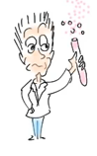
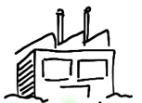
Technology Commercialization
IP Licensing (Patent, Process, etc.)
Stand-alone Startup

Slide 7
How Are Companies Organized?
Companies are organized around Business Models

Slide 9
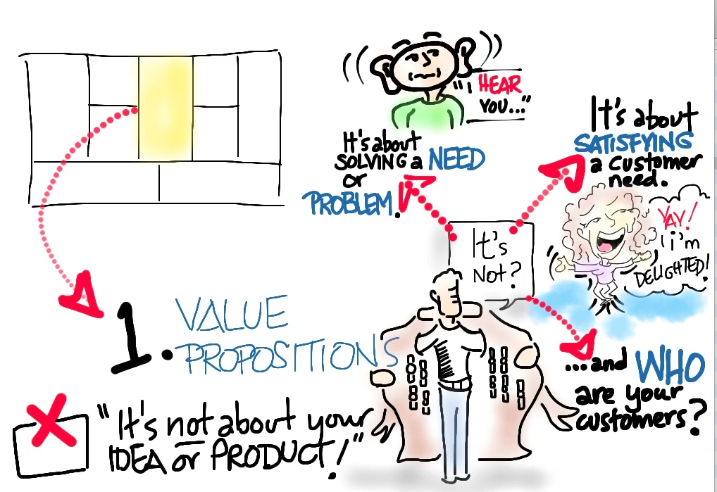

Slide 10
What About My Technology?
Your technology is one of the many critical pieces necessary to build a company.
It is part of the “Value Proposition”

Slide 19
But, Realize They’re Hypotheses

Slide 20
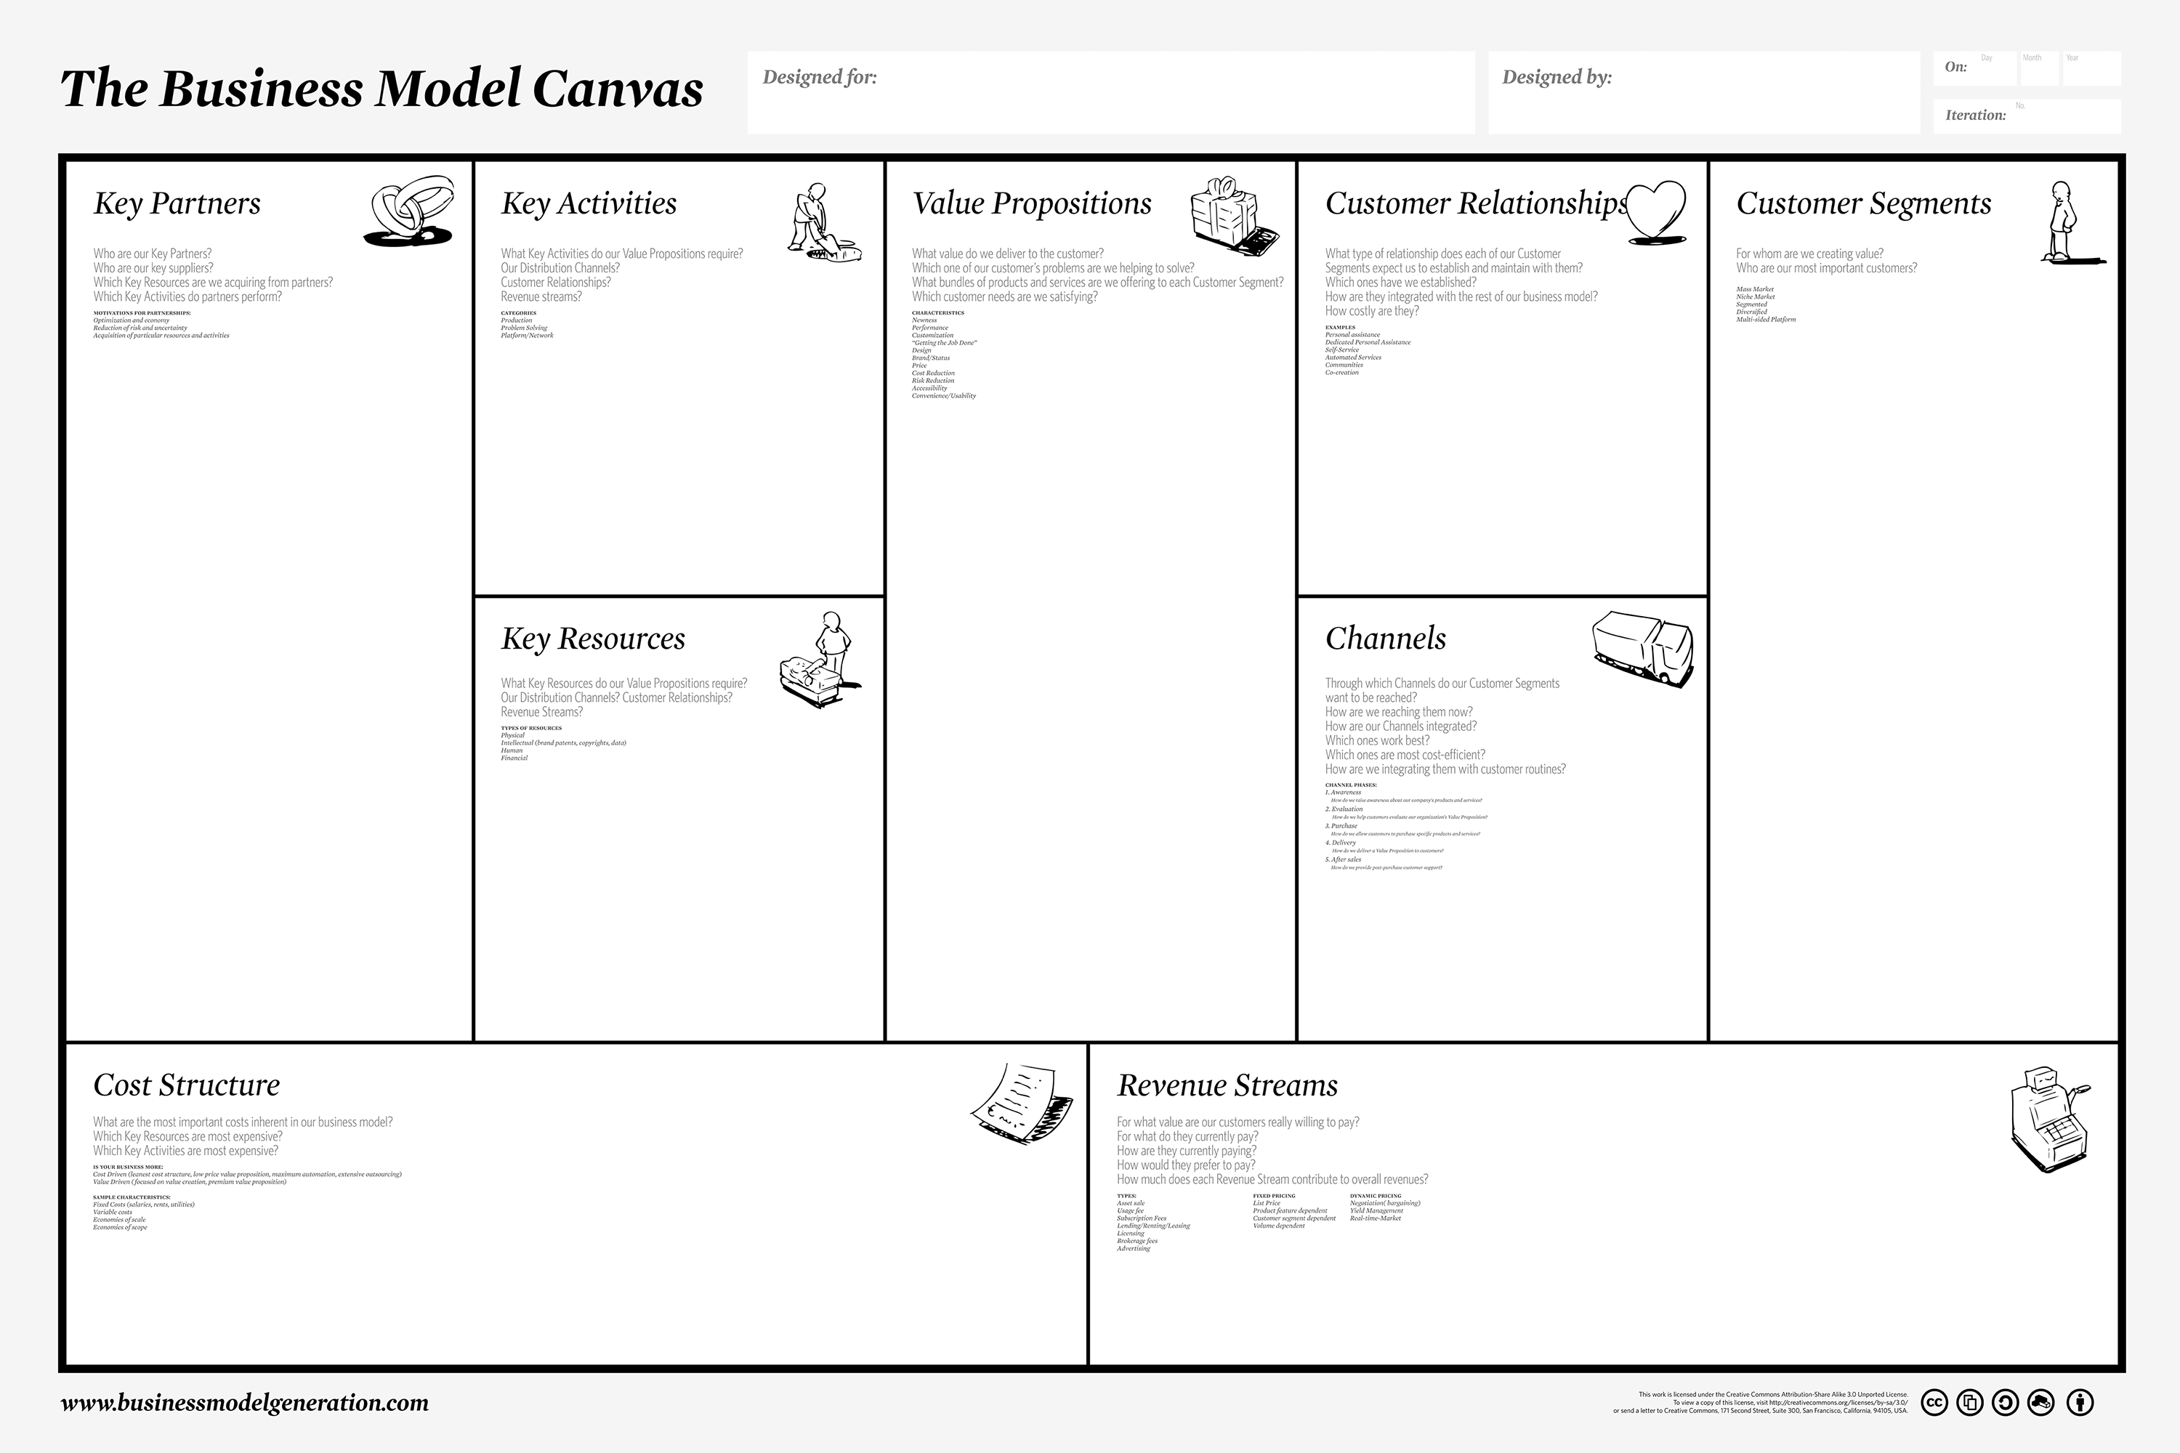
9 Guesses
Guess
Guess
Guess
Guess
Guess
Guess
Guess
Guess
Guess

Slide 21
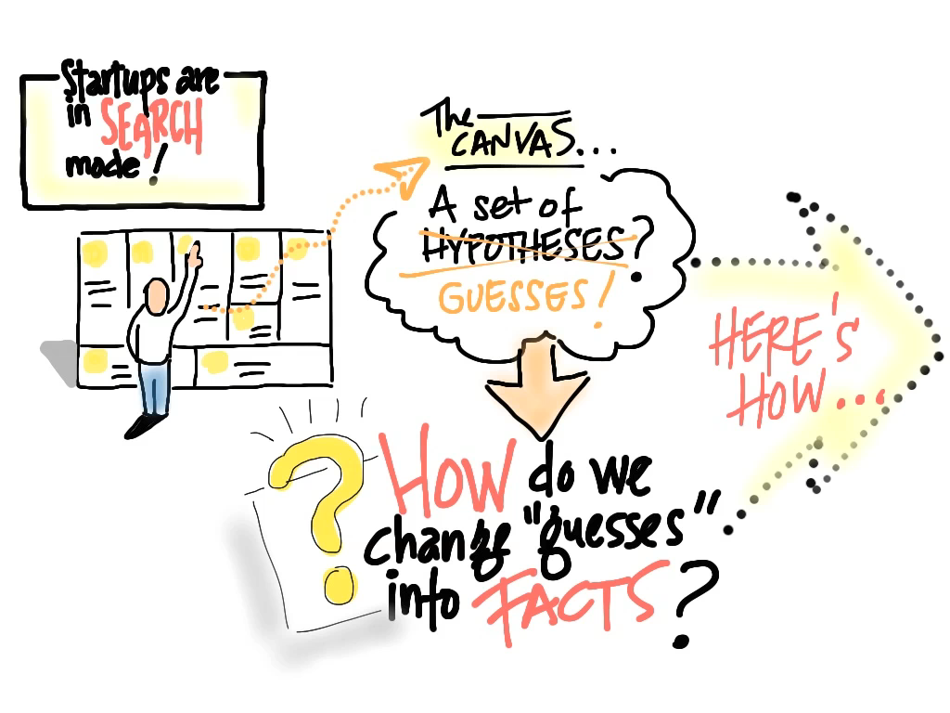

Slide 23
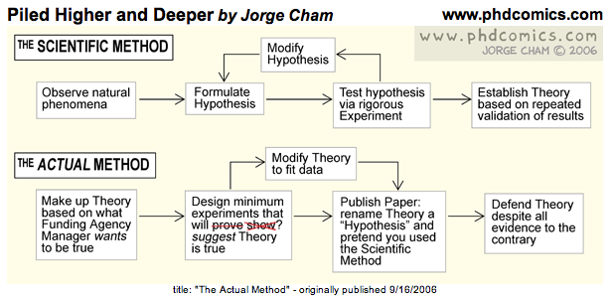
©2006

Slide 24
Customer Development
Test the Problem, Then the Solution

Slide 26
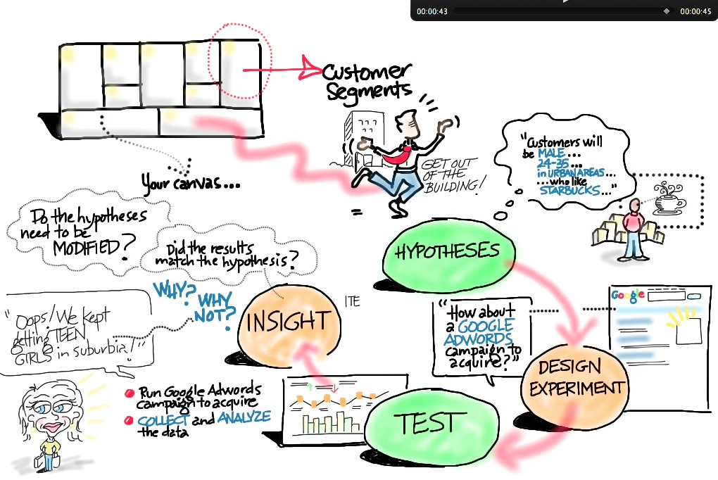


Slide 27
Customer Development
The Minimum Viable Product

Slide 29
Customer Development
The Pivot

Slide 31
Customer Development
Details

Slide 32
Customer Development is how you search for the model

Slide 33
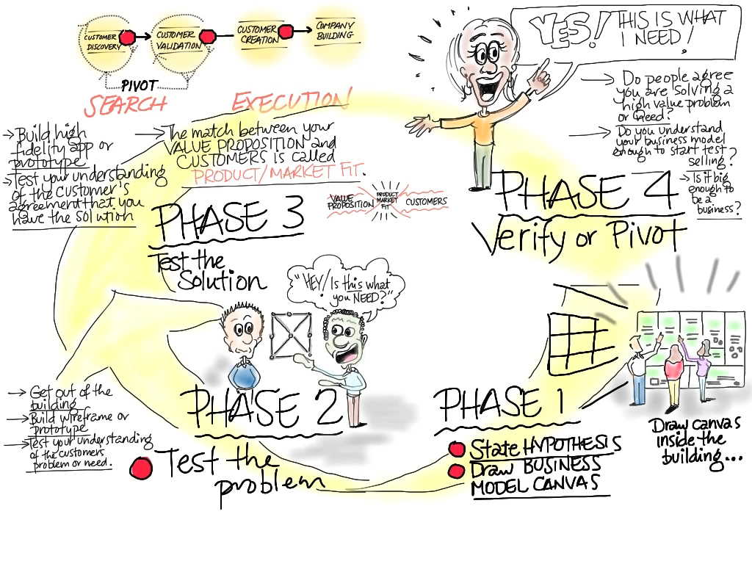

Slide 34
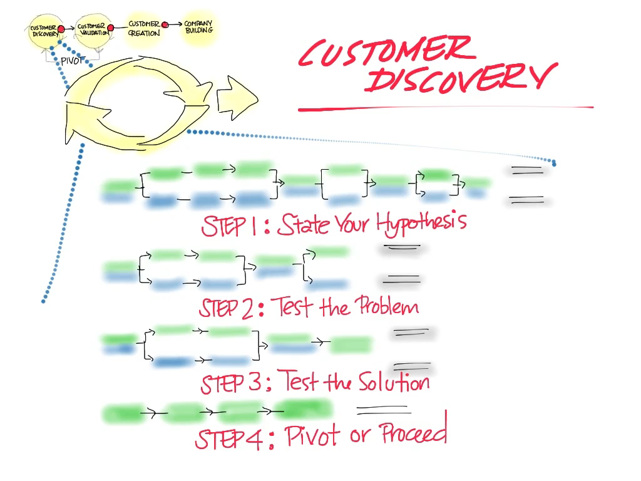

Slide 35
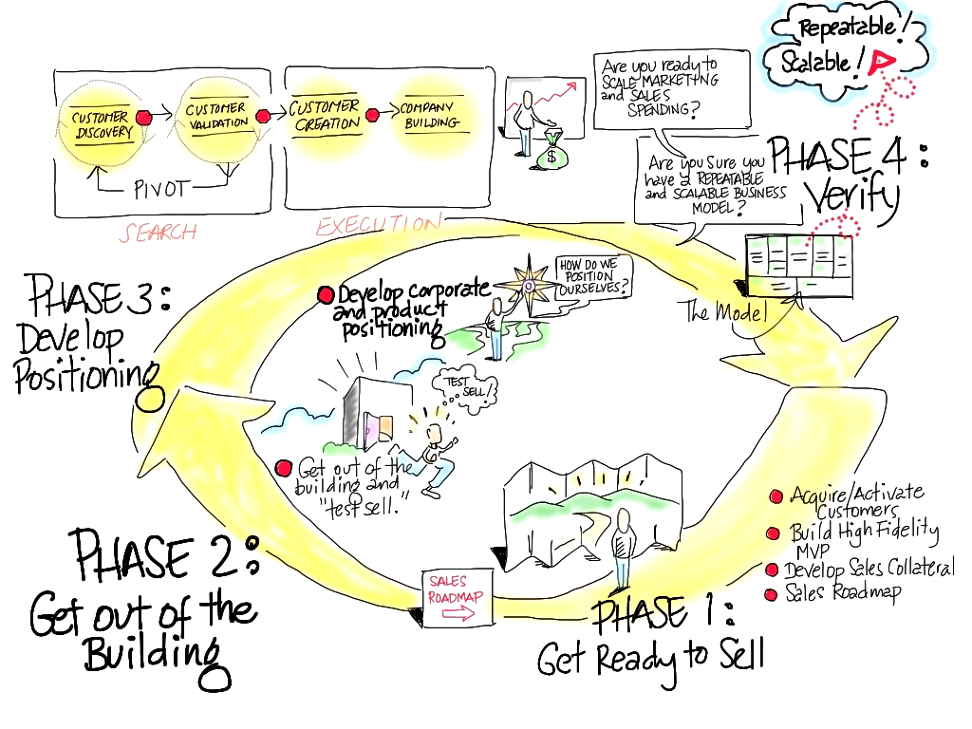

Slide 36
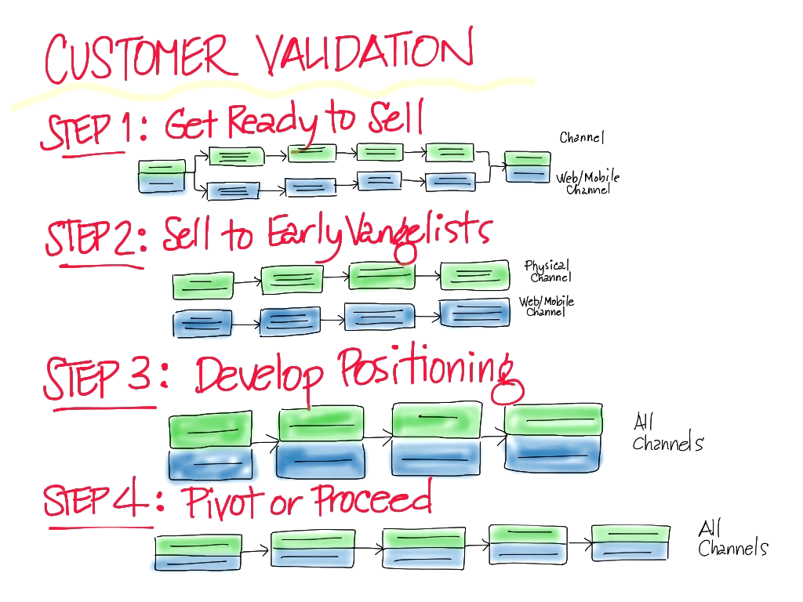

Slide 37
How to Build A Startup
Idea
Size of the Opportunity
Business Model(s)
Business Model(s)
Size of the Opportunity
Customer Discovery
Customer Validation
Theory
Practice

Slide 38
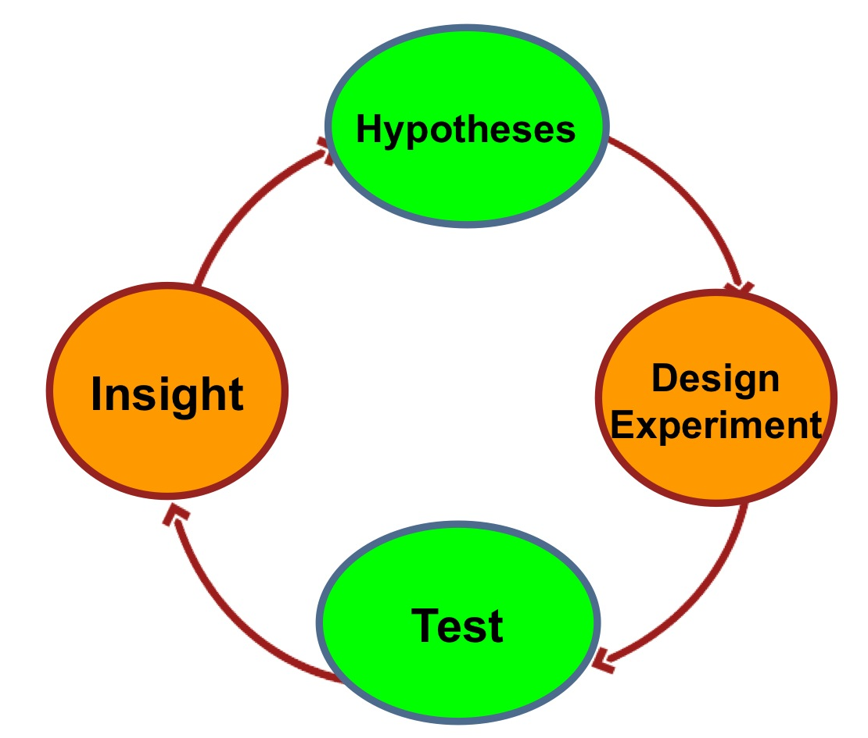
How to Build A Startup
Idea
Size of the Opportunity
Business Model(s)
Business Model(s)
Size of the Opportunity
Customer Discovery
Customer Validation

Slide 39
How to Build A Startup
Idea
Size of the Opportunity
Business Model(s)
Business Model(s)
Size of the Opportunity
Customer Discovery
Customer Validation
First test the problem
Next test the solution

Slide 40
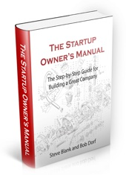
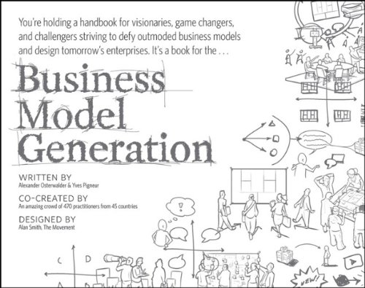
How to Build A Startup
Idea
Size of the Opportunity
Business Model(s)
Business Model(s)
Size of the Opportunity
Customer Discovery
Customer Validation

